Slide 1
Clipping
CSCI 440
textbook section 8.3-8.7

Slide 2
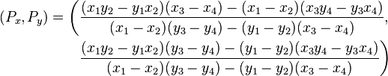
Starter Question
How do we clip these lines?
X=-5
X=5
Y=5
[3,3]
[0,0]
[0,-3]
[7,-3]
Y=-5
formula from wikipedia

Slide 3

Goals of Clipping
Reject, Accept, or Accept a portion
Do it Fast!
limit multiplication and division
In WebGL, clipping is done by hardware after transformation and before rasterization.

Slide 4
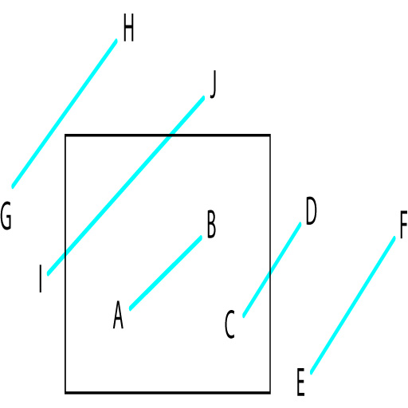
Line Clipping Cases
Angel figure 8.7

Slide 5
Cohen-Sutherland Clipping
Limits floating point division. Mostly uses subtraction and bit operations.
For each endpoint, determine the "outcode".
There are four conditions for outcodes:
both endpoints are inside the clipping window (accept)
one endpoint is inside the clipping window (accept partial)
both endpoints outside and on same side of the window (reject)
both points outside, but might intersect clipping window (accept partial, maybe)
Do line intersection (with division) for cases 2 and 4

Slide 6
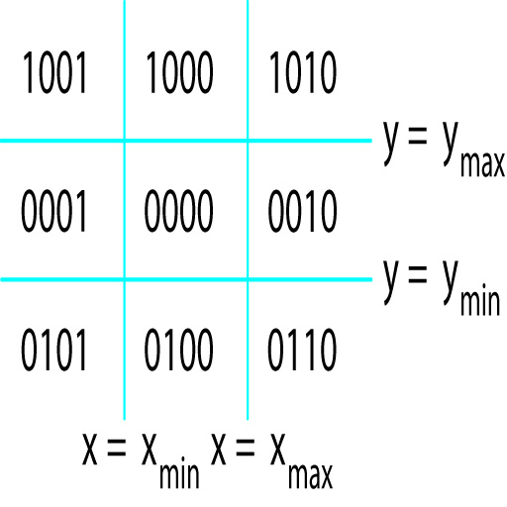
Outcodes
Outcode = b₀b₁b₂b₃
b₀ = is y > y_{max}
b₁ = is y < y_{min}
b₂ = is x > x_{max}
b₃ = is x < x_{min}
Angel figure 8.6

Slide 7
Line Clipping Cases
O₁ = outcode (x₁,y₁)
O₂ = outcode (x₂,y₂)
O₁ = O₂ = 0
both endpoints are inside the window
for example, line AB
O₁ ≠ 0, O₂ = 0 or vice versa
for example, line CD
create a new line segment between point C and intersection of CD and X=X_{max}

Slide 8
Clipping Cases…
O₁ & O₂ ≠ 0
bitwise AND
both endpoints are on same outside edge
for example, line EF
discard entire line
O₁ & O₂ = 0
both endpoints are outside the window, but outside of different edges
for example, lines GH and IJ
calculate line intersection

Slide 9

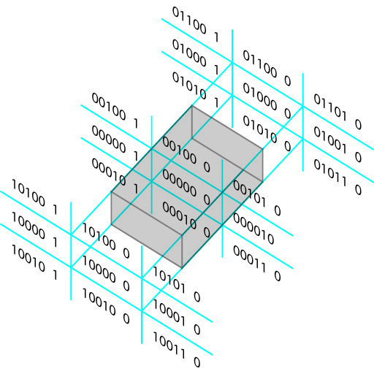
Cohen-Sutherland in 3D
Angel figure 8.22

Slide 10
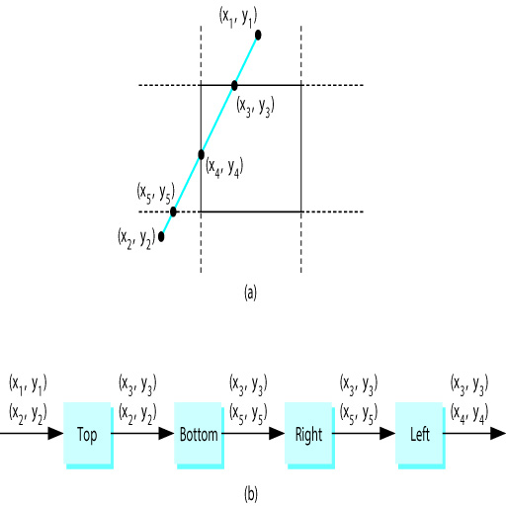
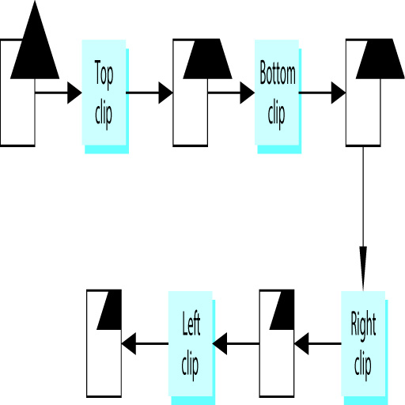
Clipping Polygons
Angel figures 8.16 and 8.17

Slide 11
Clipping Polygons
Note that clipping triangles is much easier and faster than clipping complex polygons. For example, clipping the red triangle can only yield one fragment, but clipping the single green star can yield multiple fragments. Hence, clipping is another reason OpenGL abandoned polygons.

Slide 12
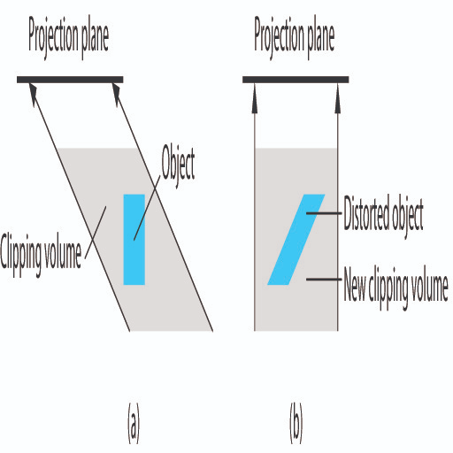
Clipping in a Perspective Projection
Shear the volume to make it a rectangular box.
Angel figure 8.26

Slide 13

Got it?
How should the line connecting these two points be clipped?
Clipping Window:
X_{min} = -1 X_{max} = 1
Y_{min} = -1 Y_{max} = 1
Line End Points:
0,0
4,4

Slide 14
Line from 0,0 to 4,4
Outcode = b₀b₁b₂b₃
b₀ = is y > y_{max}
b₁ = is y < y_{min}
b₂ = is x > x_{max}
b₃ = is x < x_{min}
So the two outcodes are:
0000
1010

Slide 15
Outcodes = 0000 and 1010
Possible Conditions:
O₁ = O₂ = 0
O₁ ≠ 0, O₂ = 0 or vice versa
O₁ & O₂ ≠ 0
O₁ & O₂ = 0
Condition 2 :
create a line segment between 0,0 and the edge of the clipping window.

Slide 16
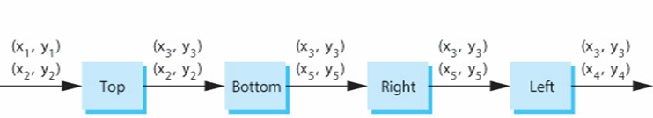
New Line Segment
(4,4)
(0,0)
(1,1)
(0,0)
Top
Y₃ = Y_{max}
X₃ = X₁ + (Y_{max} - Y₁)
X₂ - X₁
Y₂ - Y₁

